Slide 1


MURTADHA ALMUSAFER

Slide 2
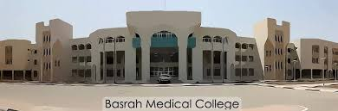
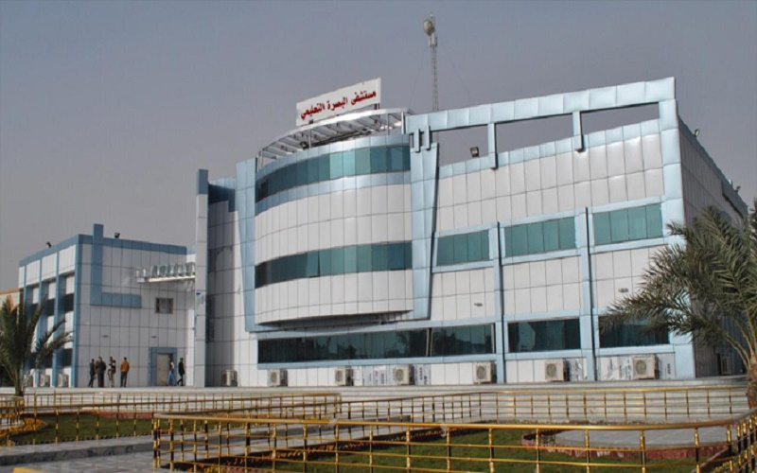
Basrah College of Medicine Basrah Teaching Hospital

Slide 3
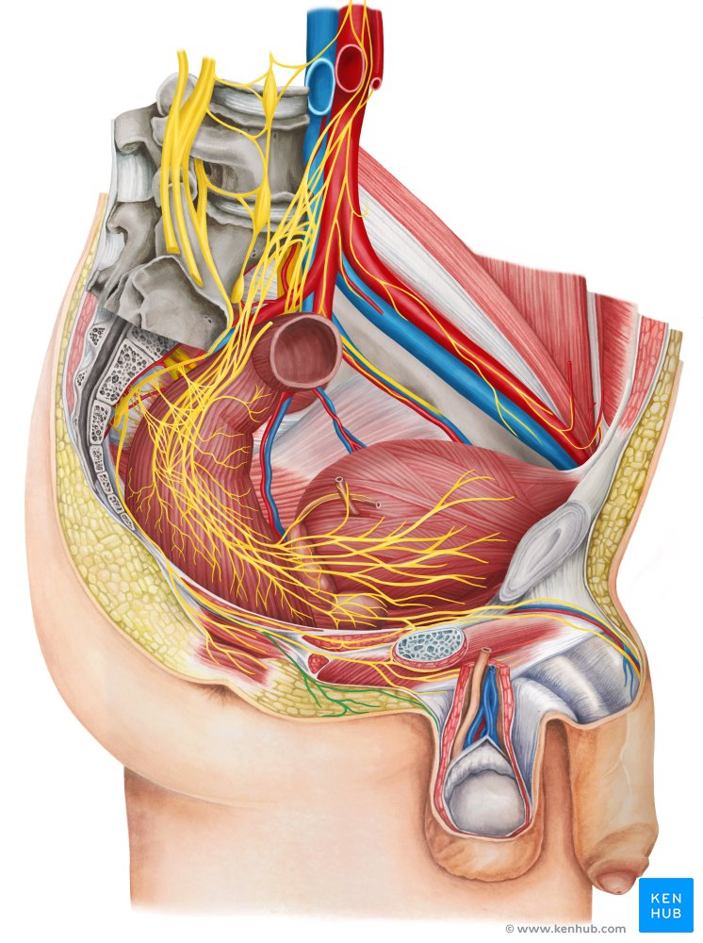
SCROTAL DISEASES

Slide 4
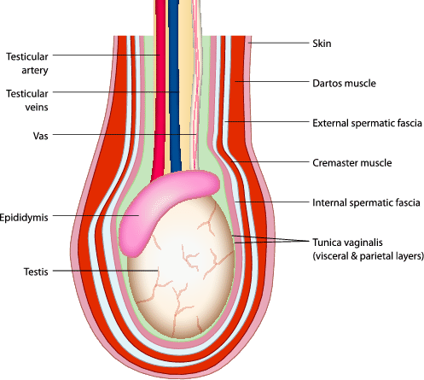
Anatomical Consideration

Slide 5
Q1: How would you manage a patient with scrotal swelling?
▼
History - Physical Examination - Investigations

Slide 6
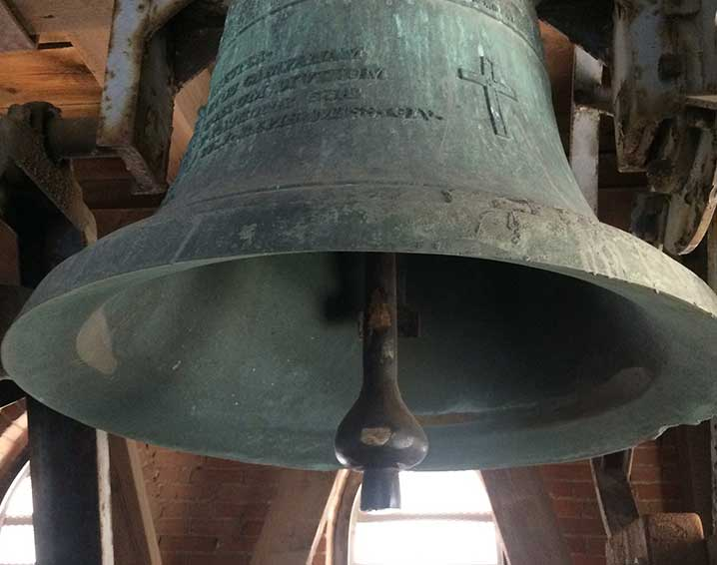
Testicular Torsion- Bell Clapper

Slide 7
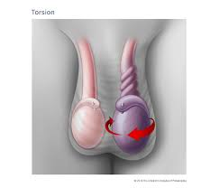
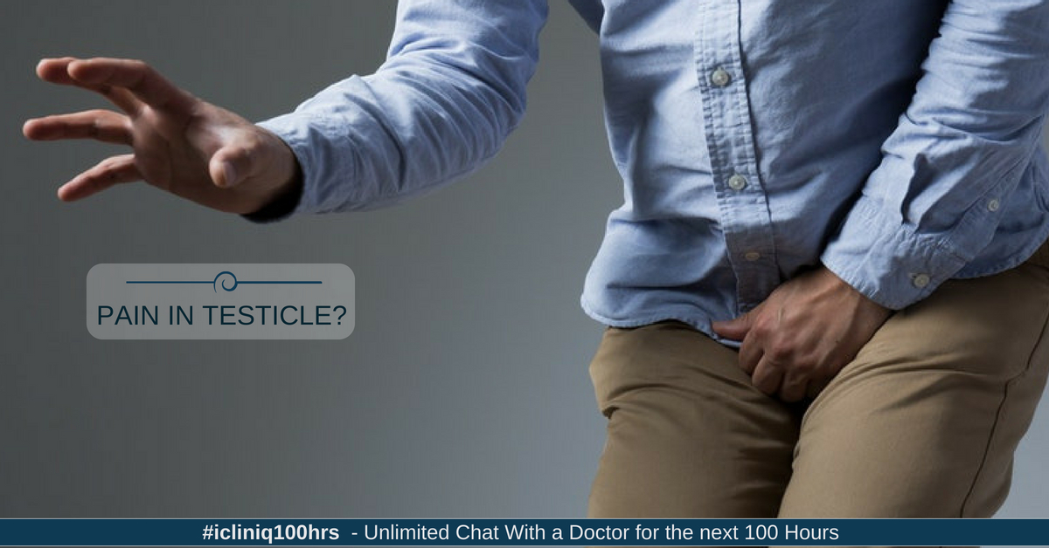
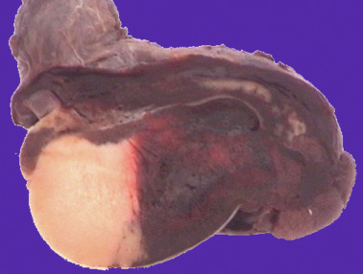
Painful Scrotal swelling

Slide 8
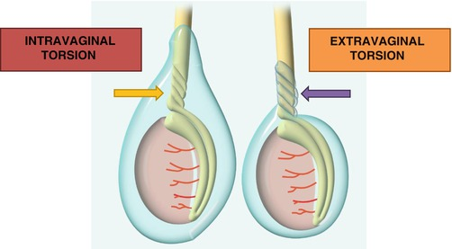
Intra & Extra- Vaginal Testicular Torsion

Slide 9
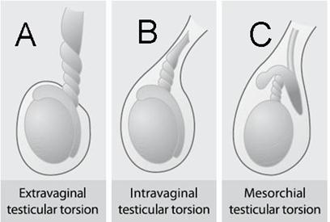

Slide 10
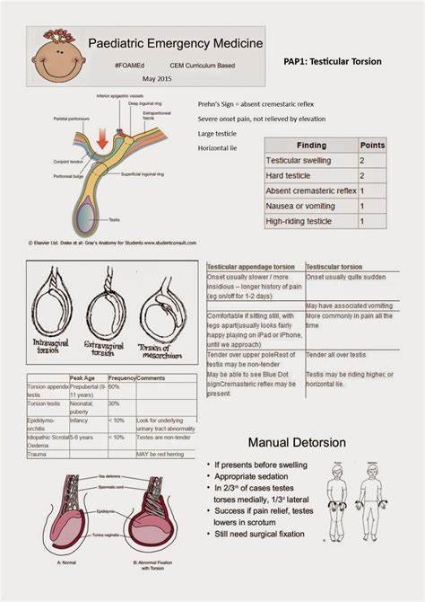
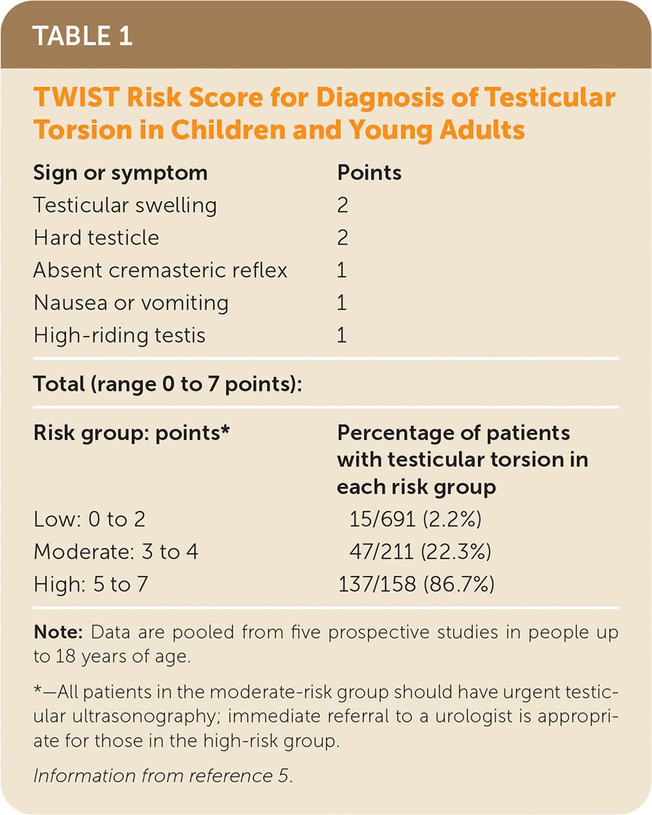

Slide 11
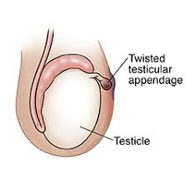
Torsion of Testicular Appendages

Slide 12
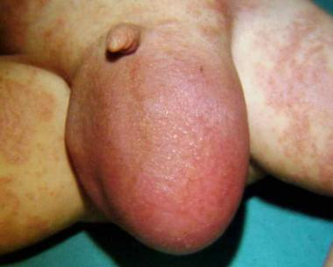
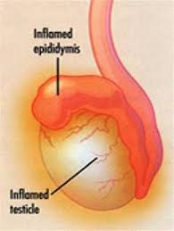
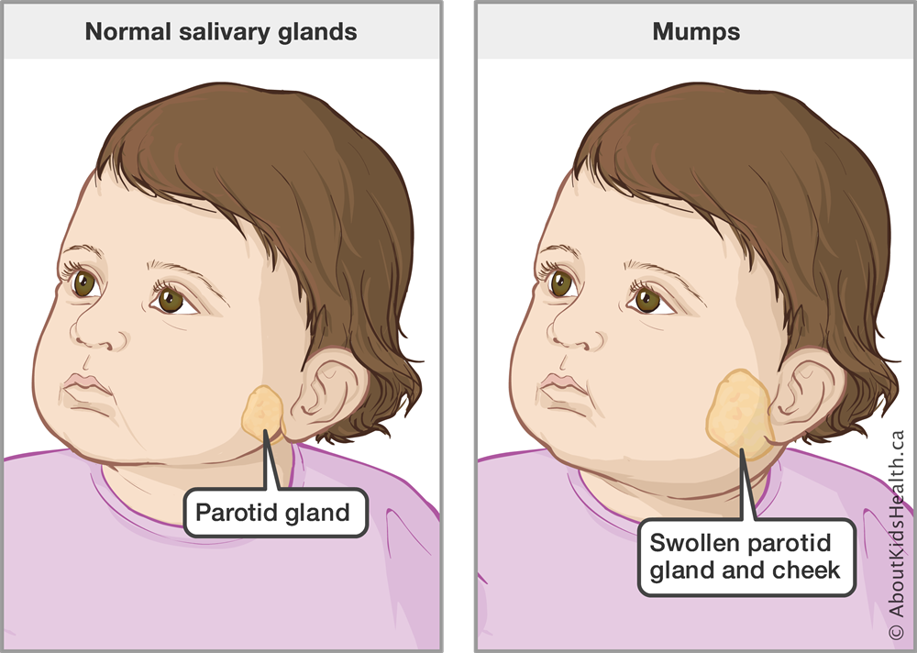
Epididymo-orchitis

Slide 13
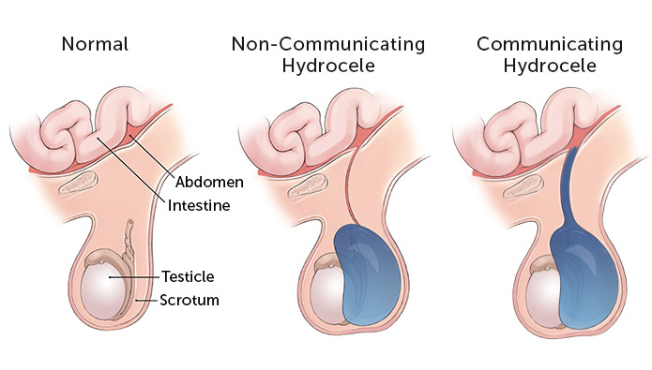
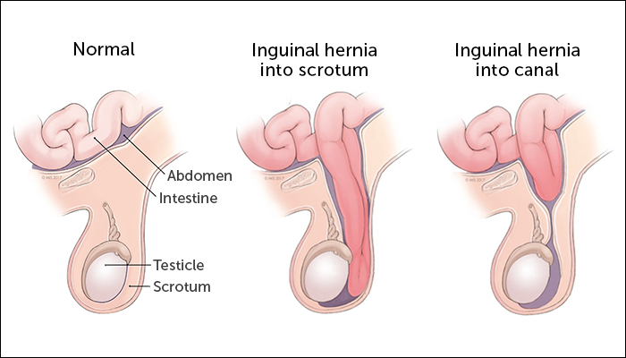
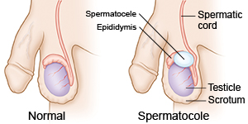
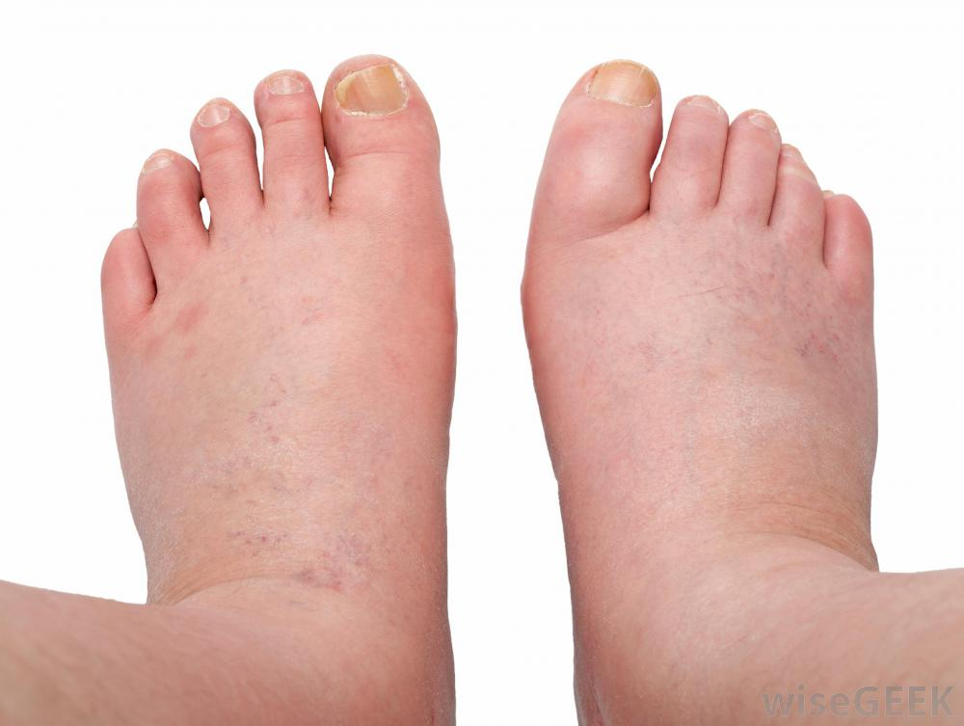
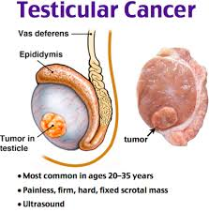
Painless scrotal swelling

Slide 14
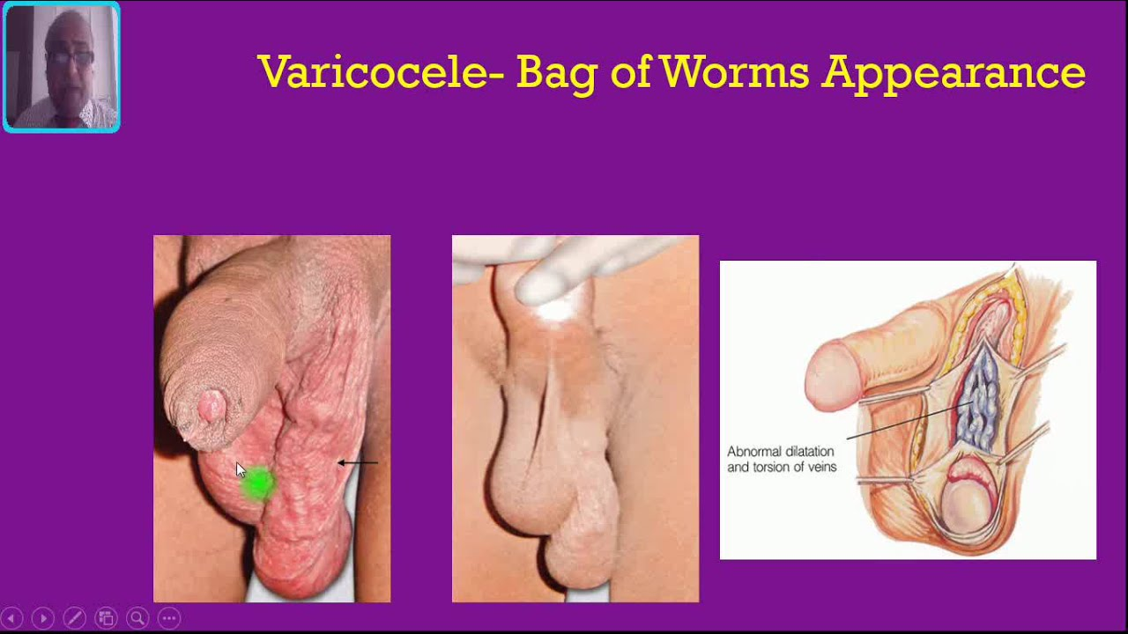

Slide 15
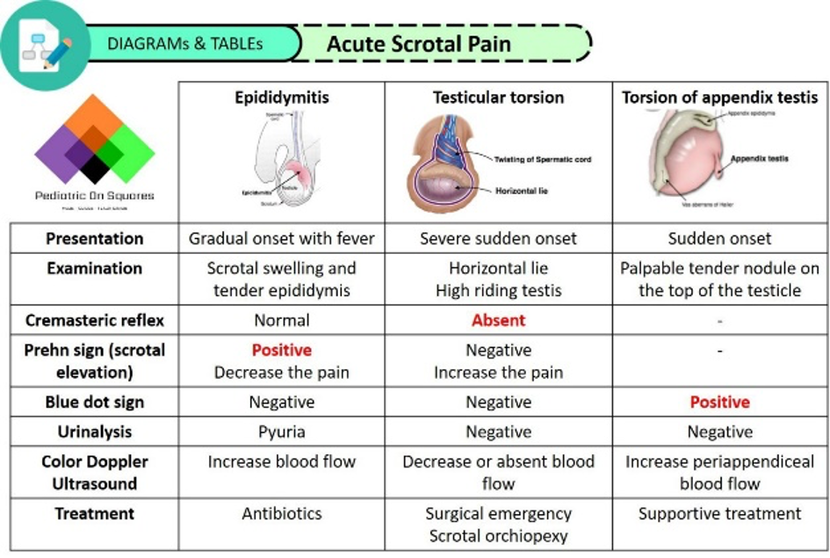

Slide 16
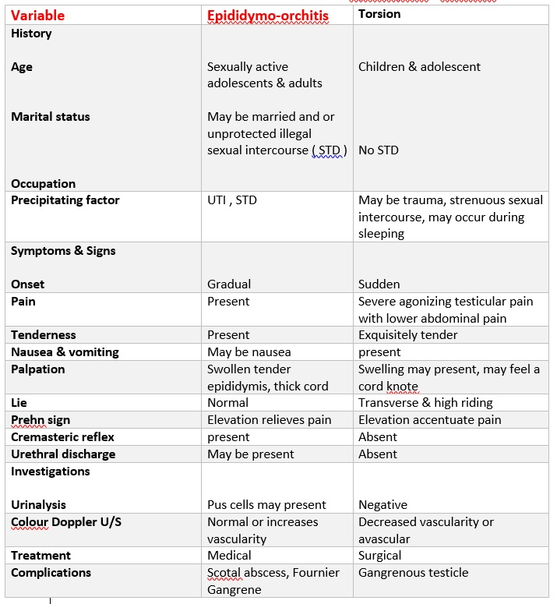
Differences between Epididymo-orchitis & Torsion

Slide 17
Other uncommon causes
Idiopathic scrotal oedema (children)
Syphilitic gumma of the testis & TB
Peritoneal dialysis & ventriculo-peritoneal shunt
Henoch-Schönlein purpura
Pancreatitis
Hidradenitis suppurativa.
Congenital abnormalities of lymphatic vessels (Milroy's disease).

Slide 18

History:
Identity ( age, marital status, occupation )
- Pain ( onset, severity, radiation, N & V )
- Fever
- Size ( gradual increase or sudden )
- Trauma , strenuous sexual intercourse, unprotected illegal sex relation
- Lifting heavy weight, chronic cough, constipation
- Abdominal or backpain, cough, hemoptysis, & dyspnea

Slide 19
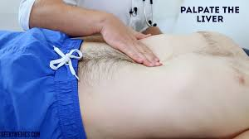
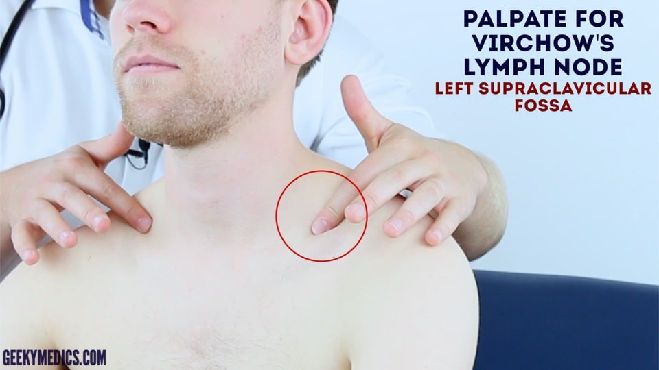
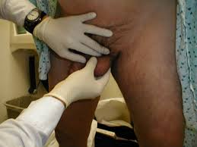
Examination
Privacy
Discuss what you are going to do
Gloves + Antiseptic Solution

Slide 20
Investigations & Imaging: Depend on the disease
1. CBC + ESR + Acute phase reactant proteins
2. GUE & Urine C&S, Urethral swab for Gram stain & C&S
3. In case of tumor suspicion: Alpha – fetoprotein, LDH, & HCG
4.Scrotal U/S , colour Doppler U/S +_ Abdominal U/S
5.C-Xray & Chest CT
6.MRI, CT of the abdomen

Slide 21
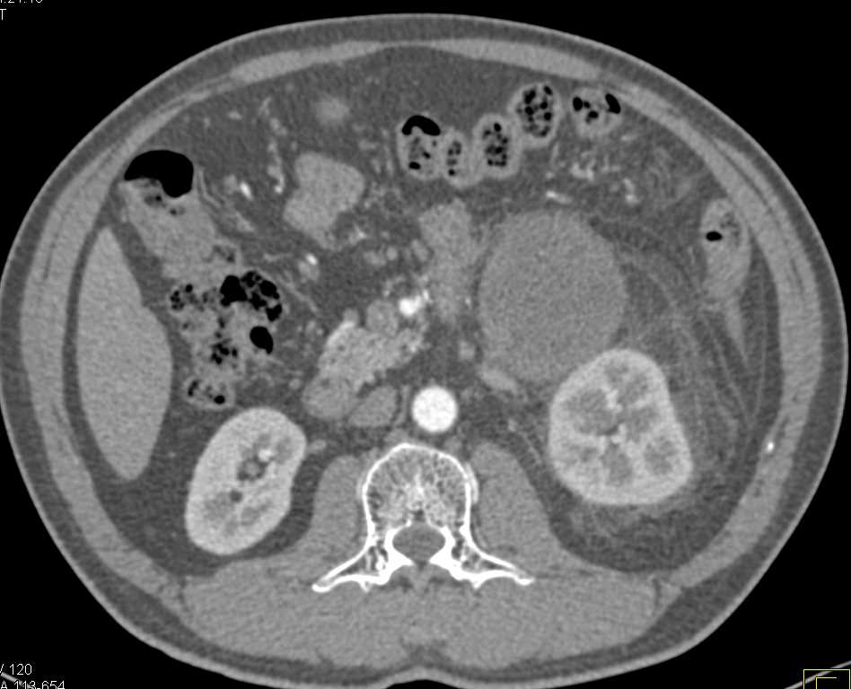
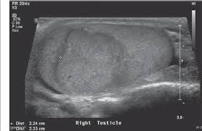
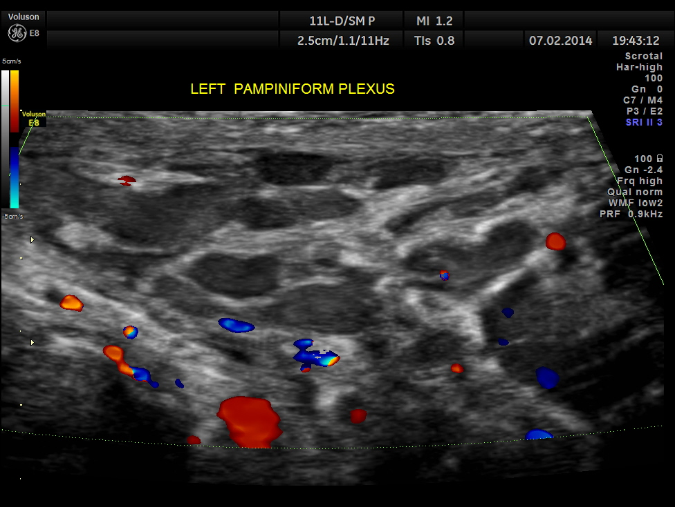
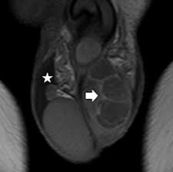
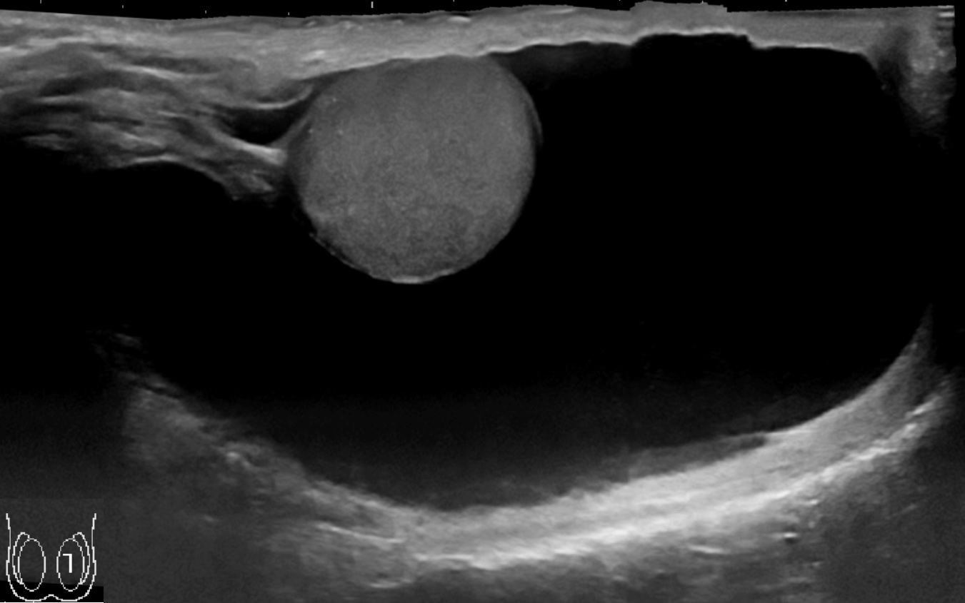
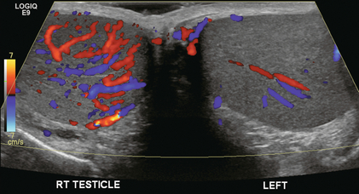
Scrotal Tumors Varicocele Torsion Hydrocele

Slide 22
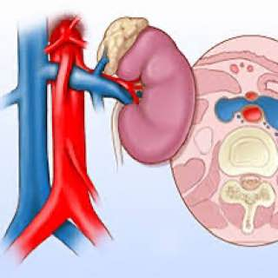
Nutcracker Syndrome

Slide 23
A teenage boy presents with left testicular pain. Which of the following options need to be excluded first?
A Orchitis
B Epididymitis
C Torsion of epididymal appendage
D Testicular torsion
E Testicular tumour

Slide 24
A 30-year-old man presents with dysuria, cloudy urine and a tender swollen right scrotum. There is history of unprotected sexual intercourse. What is the most likely diagnosis?
A Epididymo-orchitis
B Angio-edema
C Torsion of epididymal appendage
D Testicular torsion
E Testicular tumour

Slide 25
Acute Epididymo-orchitis: TRT
1.Admission
2. Elevation
3.Antibiotic ( Urethral swab for Gram stain, C& S )
4.Antipyretic & analgesic
5.Development of complications

Slide 26
TRT of Varicocele
Varicocelectomy :
open surgery, laparoscopic, embolization in recurrent cases
Indications:
1. Pain
2.Testicular atrophy
3. Infertility

Slide 27
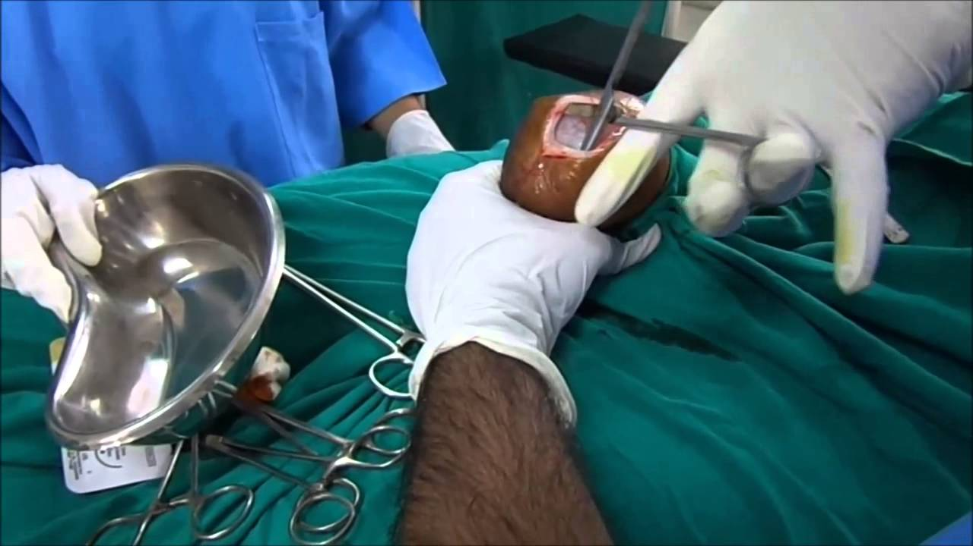
TRT of Hydrocele
Hydrocelectomy :
Jaboulay’s + Lord’s Procedures
Indications
1.Pain ( large & compressing the testis )
2.Cosmetic
3.As a result of underlying cause like tumor
4.Complications like infection

Slide 28
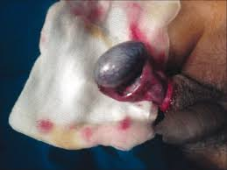
Testicular Torsion
Is an emergency
1.Admission
2.Time factor is very important
3.Exploration: Orchidopexy + Orchidopexy of contralateral side
4.Orchidectomy for non – viable testis

Slide 29
Fournier’s Gangrene
vascular disaster of infective origin that is characterized by:
1.Sudden scrotal inflammation.
2.Rapid onset of gangrene leading to exposure of the scrotal contents.
3.The absence of any obvious cause in over half the cases.
Predisposing Factors
Diabetes mellitus, it can follow minor injuries or procedures in the perineal area such as bruise, scratch, urethral dilatation, injection of hemorrhoids, or opening of a periurethral abscess.
Causative Organisms
Hemolytic streptococci are associated with other organisms ( staphylococcus, E.coli, Clostridium welchi) in a fulminating inflammation of the subcutaneous tissue, which results in an obliterative arteritis.

Slide 30
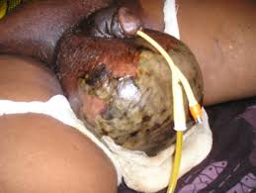
Idiopathic Scrotal Gangrene = Fournier’s Gangrene

Slide 31
Clinical Features:
1.Sudden pain in the scrotum.
2.Prostration.
3.Pallor and pyrexia.
4.Cellulitis spreads until the entire scrotal covering sloughs, leaving the testes exposed but healthy.
5.Crepitus which may spreads along the fascial planes.
Treatment
1.Swab for culture and sensitivity.
2.Antibiotics like gentamicin and cephalosporin until the bacteriological report is available.
3.Wide local excision of the necrotic scrotal skin

Slide 32
TRT of Testicular Tumors
According to Staging and Histological Diagnosis( after radical orchidectomy)
Seminoma:
Stage I: Surveillance after orchiectomy. Adjuvant radiotherapy and carboplatin-based chemotherapy are less preferred alternatives.
Stage IIA or IIB: seminoma with a lymph node ≤3cm, radiation therapy or multi-agent cisplatin-based chemotherapy based on shared decision-making.
For patients with IIB seminoma with a lymph node >3 cm, chemotherapy is recommended.
Non Seminoma Management – RPLND/Chemotherapy

Slide 33
Teratomas
Are less sensitive to radiation
A. Stage I can be managed by monitoring the levels of serum markers and by repeated CT.
B. Stage II-IV are managed by chemotherapy. Cisplatin, methotrexate, bleomycin and vincristine have been used in combination with great success.

Slide 34
THANK YOU

